Slide 1
My Wellness Plan
Insert Your Name Here

Slide 2
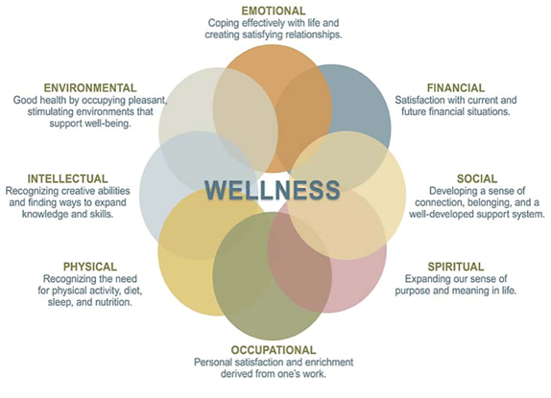

Slide 3
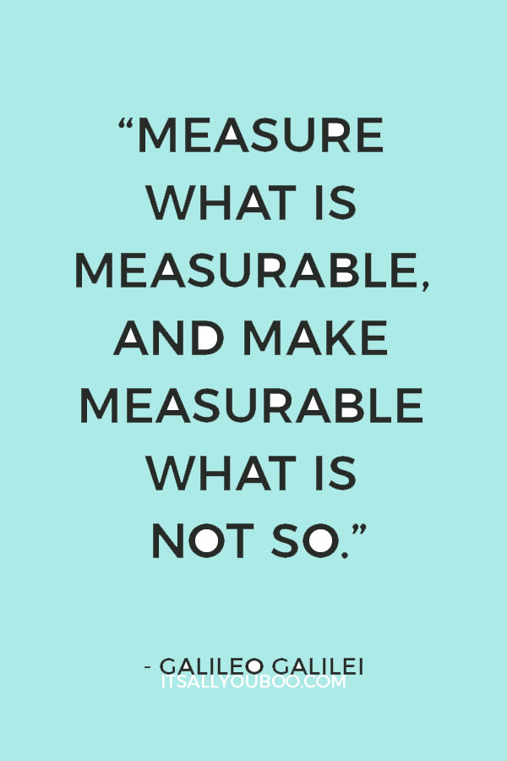

Slide 4
Wellness Baseline Assessment
Based on your thoughts TODAY,
rate your satisfaction in each domain of wellness
by placing an “x” in the appropriate box
1= Not satisfied at all; 10= Could not be more satisfied
Date: | 1 | 2 | 3 | 4 | 5 | 6 | 7 | 8 | 9 | 10
Emotional
Financial
Social
Spiritual
Occupational
Physical
Intellectual
Environmental

Slide 5
What have you learned?

